Slide 1
Group 5 Project; Part 3
Kerri Easterbrook, Xiazhi Fang, Madlen Ivanova, Diana Kinney, Mahalakshmi Vishnampettai Raghuraman, Aravindharaj Rajendran, Divya Ravi
DSBA-6100-U01
May 11, 2016

Slide 2
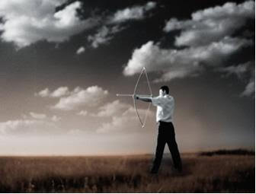
Objective
To gain insight into the relationships between Fortune 500 company performance, analytics, innovation, social responsibility, patent development, and current political climate in order to make valuable predictions.

Slide 3
Process Flow
Objective
Impacts of social responsibility, patent development and political climate on Fortune 500 company performance
Data Sourcing
Innovation – Patents, Economy – GDP, Politics – Election Data
Data Staging
Structured - Excel / MS Access
Semi-structured – File System
Data Preparation
Tokenization & Stemming, Stop Words Removal – Patent Abstract & Titles, Missing Data – Omission/Imputation
Data Mining
Patents – MapReduce, Word Cloud, Topic Modeling – Mallet
Measures
Testing - Recall
Descriptive Measures - R Studio
Visualization
Patterns, Variable Relationship Analysis - Tableau
Insights / Recommendations
Variables, Relations, Relevant Data Consolidation, Hypothesis Prioritization

Slide 4




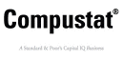


Data Collection
List of sources we collected from
Structured Data:
Federal Archives
CompuStat
FEC.gov
US Census Website (NAICS)
Semi-Structured Data (Patents):
US Patent Trademark Office
Data.epo.org

Slide 5
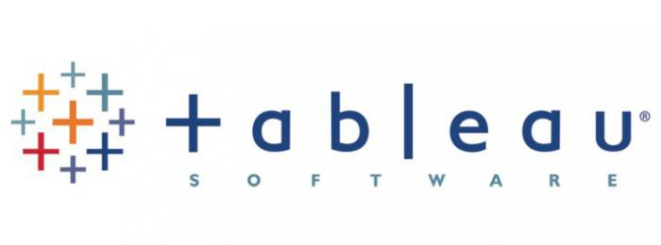





Data Mining & Visualization
Technology stack:
Java - MapReduce
Eclipse IDE - Development and Testing
SAS - Analysis/Company name sounds like
MS Access - Data preparation and mapping
IBM Word Cloud - Visualization using word cloud
Mallet - Topic modeling
Tableau - Visualization of variable relationships, trends

Slide 6
Data Mining
Deployment/Execution
DSBA Hadoop Server
INPUT
XML Patent Files
PROCESSING
MapReduce
OUTPUT
1. Org name & patent count
2. Patent Title
3. Patent Abstract
Development
Eclipse IDE on Cloudera Hadoop distribution

Slide 7
Data Cleansing & Transformation
Company Name- Patent Count
Map Reduce Output
Company Names Pulled
SAS-”sounds like” function
Fortune 500 Companies filtered out
Non-Fortune 500 Companies manually removed
Fortune 500 Company Name Versions Table Created
Structured Data Imported into MS Access DB
Joins based on Ticker Symbol
Mapped to Ticker Symbol
Tokenized
Stemmed
Converted to lowercase
Stop words removed
Company Names Standardized

Slide 8
Data Descriptive Statistics
14,897 Total Records
40+ Variables Collected & Examined
485 Fortune 500 Companies (97%) – mutuals & private organizations not included
Average Revenue = $11,574 million
Average Net Income = $658 million
Average R&D Expense = $436 million
1,883 records with US Patent Count (13%)
1,132 records with European Patent Count (8%)
Total Patent Average = 170, Median = 23, Range = 1 to 7,534
6,812 records with CSR scores (46%)
Total CSR Average = 0, Median = 0, Range = -9 to 12

Slide 9

Relationships between variables
Correlations – 95% of the pairings had a statistically significant relationships (at alpha level of 0.05).
Scatter Plots used to determine practically significant relationships.
The strongest & most interesting relationships were between:
Research & Development Expense (innovation level)
US Patent Count
Revenue

Slide 10
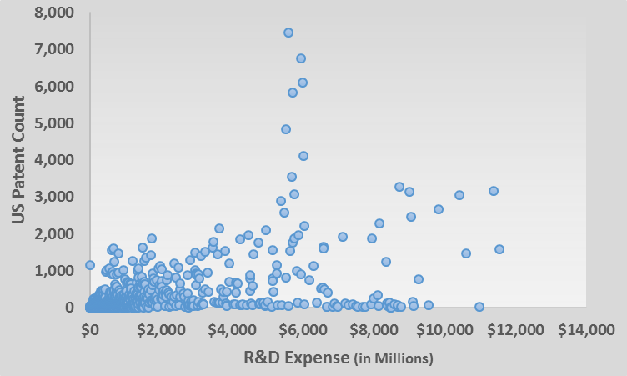
Relationships between variables
All Fortune 500 Companies

Slide 11
Relationships between variables
IV: R&D Expense, DV: US Patent Count
p<0.01, R² = 0.85, coefficient = 0.84
It costs $1.2 million R&D to produce 1 patent.

Slide 12
Relationships between variables
IV: US Patent Count, DV: Revenue
p<0.01, R² = 0.58, coefficient = 43.32
For every 1 patent, will see $43 million increase in revenue.

Slide 13
Corporate Social Responsibility (CSR) Cluster Analysis
No CSR Participation - low revenue & patent count
Most Committed to CSR – high revenue & patent count
Includes Walmart and its competitors, and IBM and its competitors

Slide 14

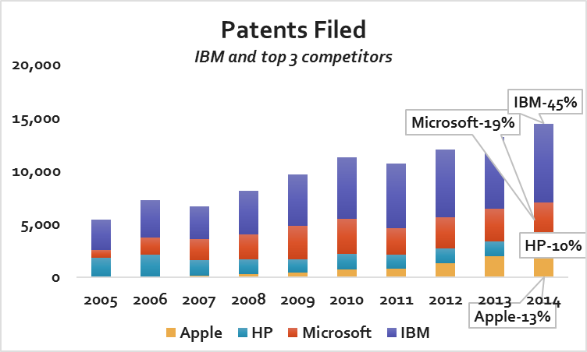
Company with most patents filed: IBM
Compared to competitors
Outperformed in number of patents by over 100%;

Slide 15
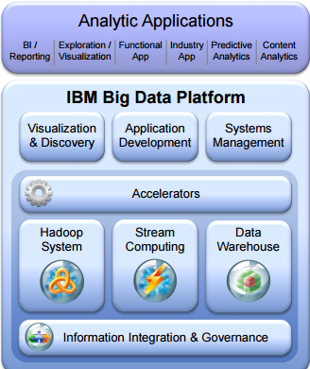
DSBA Strategy : How?
IBM’s integrated big data platform has four core capabilities:
Hadoop-based analytics
Stream computing
Data warehousing
Information integration & Governance
“ Faster, easier, smarter analytics”

Slide 16
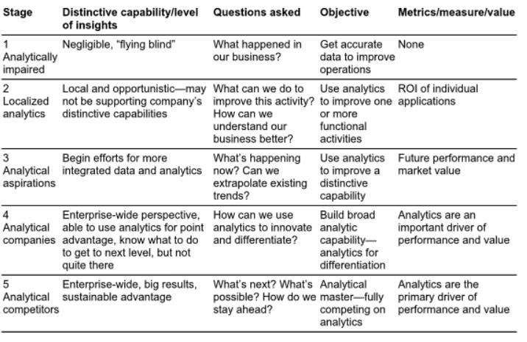
Davenport & Harris Spectrum – Stage 5

Slide 17
Davenport & Harris Spectrum – Stage 5
Innovation is the primary strategy and distinctive capability
Cloud, data analytics, mobile, social, and security
Using analytics to stay ahead of competition
Determining the most profitable innovation
IBM helps everyone across the enterprise forge a path to proficiency with analytics.

Slide 18





Featured business analytics solutions
Business Intelligence
Enterprise performance management
Prescriptive analytics
Predictive analytics
Risk management

Slide 19


Competitive advantage
IBM's core strengths are its five "strategic imperatives“:
cloud data analytics, mobile, social, and security businesses.
The company has been transforming itself into a Big Data and Analytics powerhouse during the last few years
First mover in cloud computing solutions for enterprises
Brand reputation – century-long history
Diversified business –hardware, software, IT services, IT consulting
Integration of products and services – end to end provision capability
Licensing out patents

Slide 20

Recommendations for IBM:
In terms of research, data science and business analytics – keep going!
Rising revenue of this sector- Every $1 spend in R&D accounts for $ 23 in revenue.
Invest more in Global Services and in its people
Improve quality
IBM should no longer cut quality, cut corners, and under-deliver on its commitments.
Continue to keep large clients satisfied while taking measures to attract smaller and mid-sized clients

Slide 21

Recommendations for IBM (continued):
Invest more in KPI Dashboards
Accessibility - IBM should continue developing its Mobile application platform
IBM MobileFirst platform

Slide 22

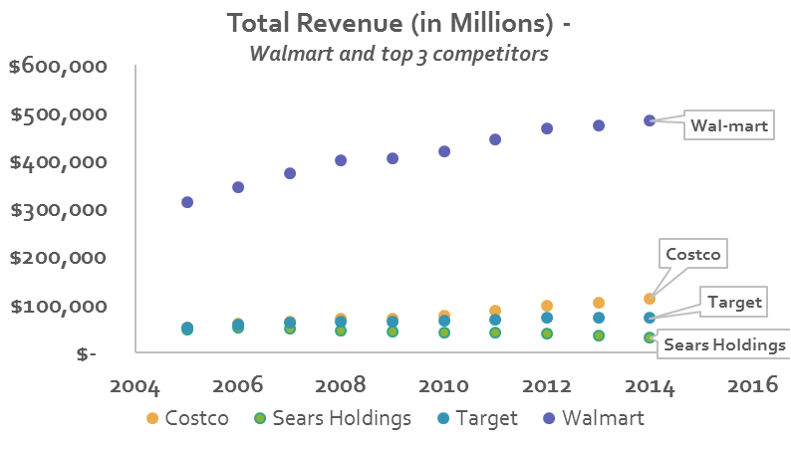
Company with highest Total Revenue

Slide 23

Competitive Advantages
Low cost structure -> EDLP Every Day Low Prices
One stop shop
Vendor relationships

Slide 24

DSBA Strategy: What?
260 million customers
11,500 stores
10 active websites
300,000 social mentions
2.2 million associates
Transacts $36 million dollars from 4,300 US stores
2.5 petabytes of unstructured data from 1 million customers every hour
Analyze close to 100 million keywords

Slide 25
DSBA Strategy : Where / How ?
Grounded in open source
Hadoop – 250 nodes in 2012
SAS – Associate & Customer behavior analytics / Online & In-store
Muppet –overcome inability of regular Map-Reduce/Hadoop framework
Polaris – search engine
Adchemy – product research for marketing initiatives
Inkiru – predictive analytics, business decision engine
OneRiot – social media signal analysis and personalization
Kosmix – social media content organization and JIT info
OneOps – cloud platform to prevent Amazon cloud lock in

Slide 26

DSBA Strategy – Who ?
Talent
@WalmartLabs – Big Data Team
Corporate Business Analytics and Intelligence
Leadership Team : BENTONVILLE, AR
Currently HIRING: 358 results in All locations for Data Scientist
Analytics Rotation Program
Entry-level - Data science associate
Senior director level - Enterprise Decision Scientist
Guide the overall company direction through statistical analysis
Programming: Python or R
Crowdsourced analytics competition platform Kaggle
Twitter #lovedata campaign
Notes:
https://www.dezyre.com/article/how-big-data-analysis-helped-increase-walmart-s-sales-turnover/109 -- May 1, 2016.

Slide 27
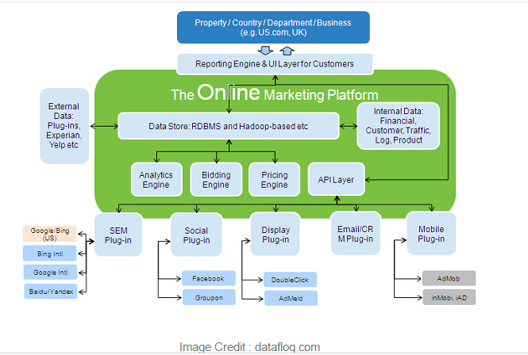
Analytical Competitiveness - Walmart
Predictive analytics models - sales patterns, profitable stores, logistics
Mobile Analytics – Savings catcher
SOURCE: https://www.dezyre.com/article/how-big-data-analysis-helped-increase-walmart-s-sales-turnover/109

Slide 28
Davenport & Harris Spectrum – Stage 5

Slide 29

Recommendations
Analytics to identify improvements:
Quality standards
HR practices
Improve CSR
Attract and retain in-store/online customers :
Subscription/Membership
Mobile shopping app
Walmart pay
Empower customers with Polaris
Compete with online retailers
Ecommerce Startup Acquisition strategy

Slide 30

Recommendations
Mobile Analytics :
22 M users out of 260 M/week: None awareness -> Awareness
Savings catcher – build loyalty
Space - Offer drive through pick up
GPS - Mobile app push notification when the car enters the parking lot.
Restocking - Incoming customer’s recent online behavior
Push notification on product aisle info
In-store assistance from mobile app

Slide 31
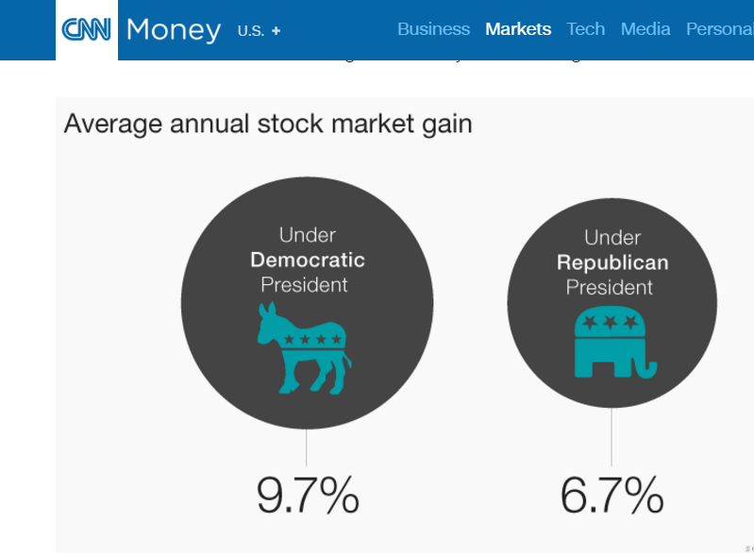
Impact of Presidential Party on Fortune 500 Companies

Slide 32
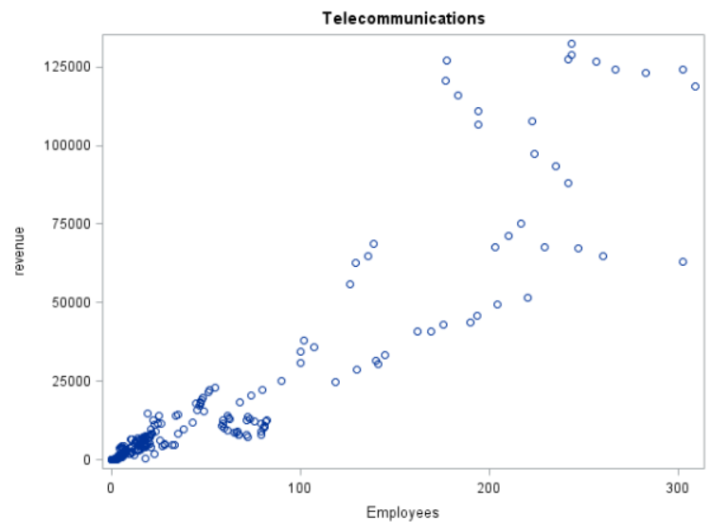
Example: Telecommunications: Revenue vs. Employees
Revenue = year + employees+ political
Telecommunications
Revenue
Employees
(In 1’000s)

Slide 33
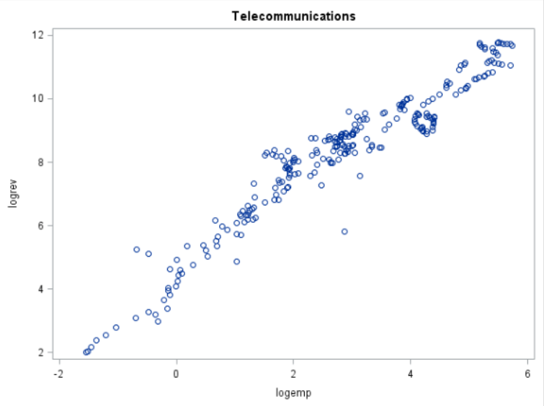
Example: Telecommunications: Revenue vs. Employees
Logrev = year + logemp + political
Telecommunications
12
10
8
6
4
2
log-Rev (in $Billions)
-2 0 2 4 6
Log-emp
(In 1’000s)

Slide 34
Predict Which Types of Firms are Impacted by President in Office
Republican:
Aerospace and Defense
Chemicals
Commercial Banks
Electronics, Electrical Equip.
Energy
General Merchandisers
Mail, Package, and Freight Delivery
Medical Products and Equipment
Metals
Motor Vehicles and Parts
Packaging, Containers
Telecommunications
Railroads
Utilities: Gas and Electric
Democrat:
Hotels, Casinos, Resorts

Slide 35

Limitations and Recommendations For Future Research
Limitations:
Fortune 500 companies only
CSR from 1991 – 2015
Patent count from 2005 – 2015
No Economic data such as inflation & taxes
No Marketing / PR data
No Congress, Senate, or Contribution data
No International data
Future research should account for the above variables

Slide 36

Questions?

Slide 37
Supplemental Information

Slide 38
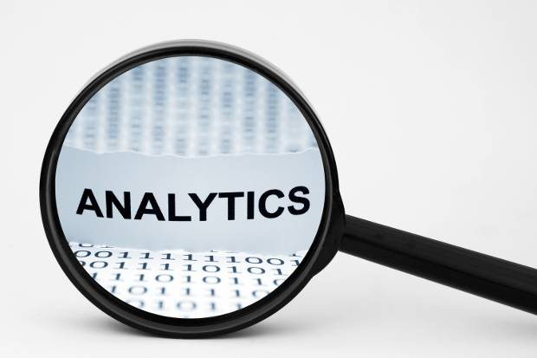
Competitive analytics
Strong competency in high-growth emerging markets- BRICs
Key drivers (Revenue):
Repeat business from customers
Billing rates – very high
Bid and Win new contracts
Key drivers (Margin):
Selling, General and Administrative Expenses (SGA)
Employee cost

Slide 39
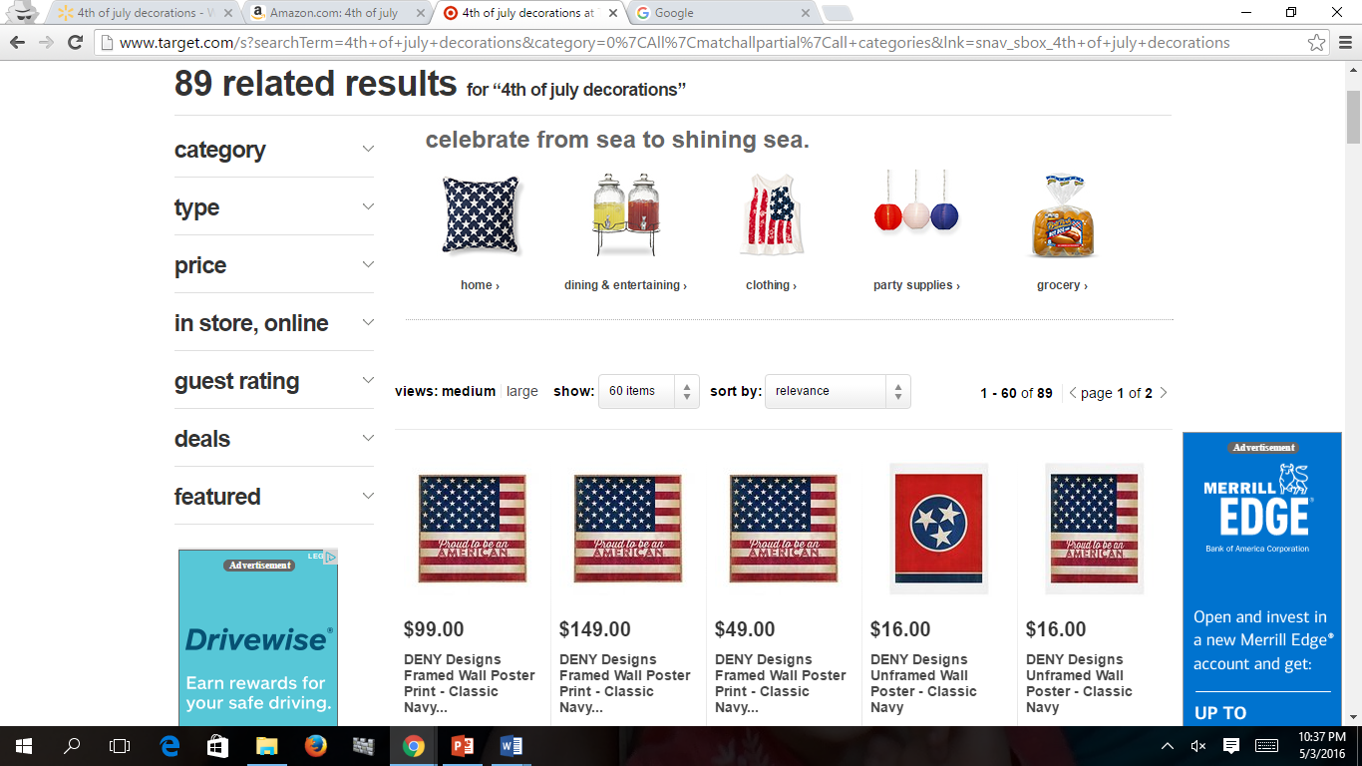

Slide 40
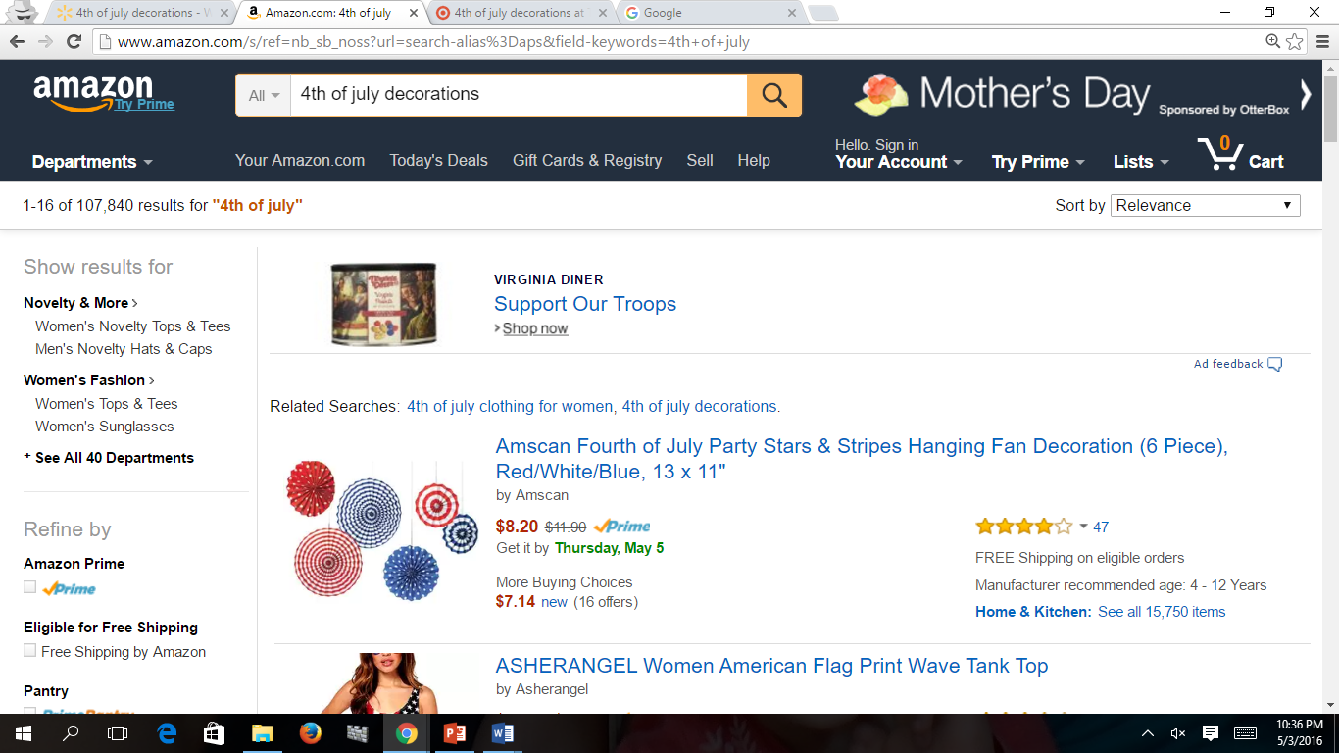

Slide 41
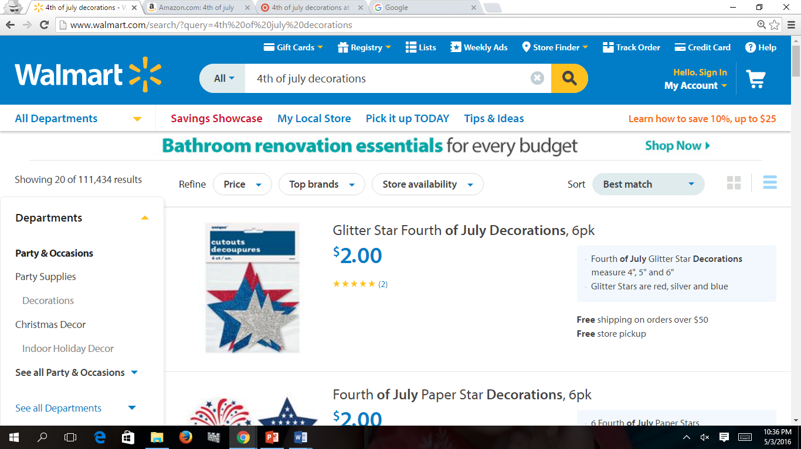

Slide 42
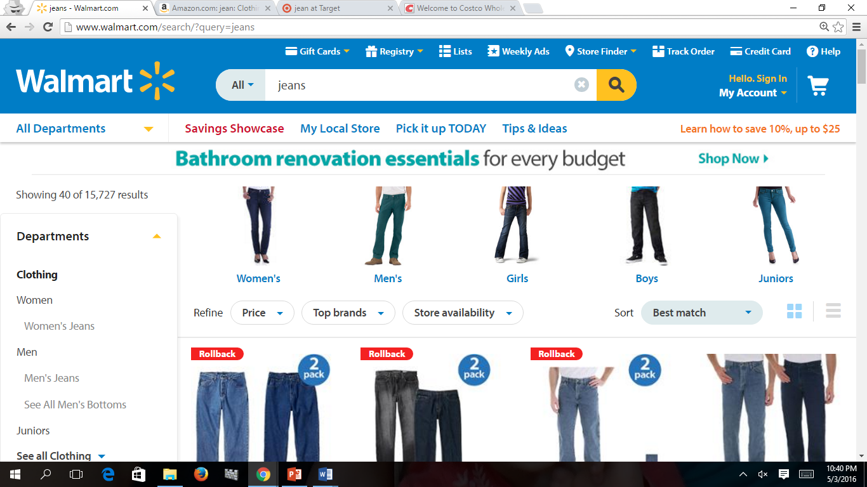

Slide 43
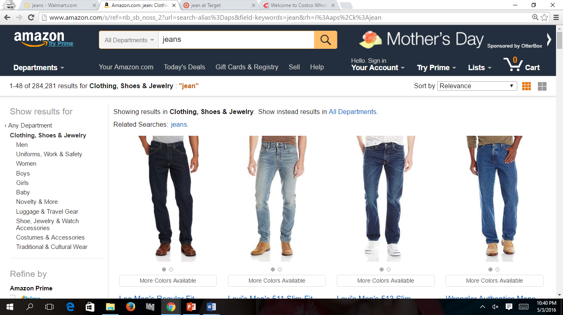

Slide 44
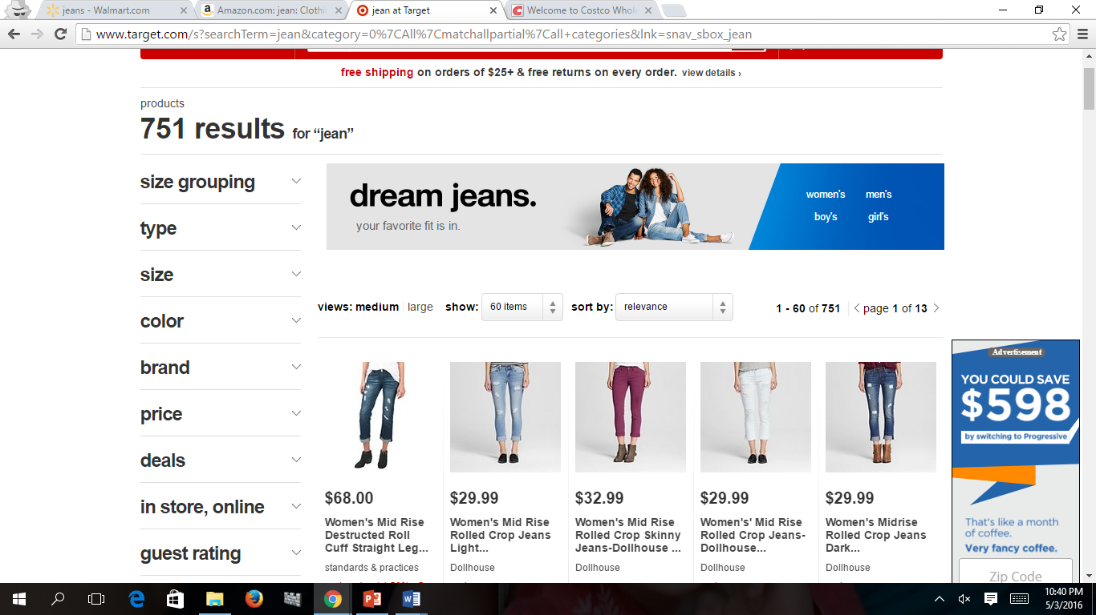

Slide 45
Model Comparison
Telecommunications
Old:
Revenue = -670392 + 334*year + 368*employees + 4377*political
R-Square: 86%
New:
Logrev = -117 + 0.06*year + 0.99*logemp – 0.08*political
R-Square: 98%
Utilities: Gas and Electric
Old:
Logrev = -132 + 0.07*year + 0.92*logemp – 0.15*political
R-Square: 95%
New:
Revenue = -454306+ 229*year + 289*employees + 533*political
R-Square: 62%

Slide 46
Outcome Comparison
Previous Outcome
New Outcome
Democrat:
Airlines
Financial Data Services
Food and Drug Stores
Food Consumer Products
Pharmaceuticals
Pipelines
Telecommunications
Transportation and Logistics
Computers, Office Equipment
Oil and Gas Equipment, Services
Utilities: Gas and Electric
Republican:
Aerospace and Defense
Chemicals
Commercial Banks
Electronics, Electrical Equip.
Energy
General Merchandisers
Mail, Package, and Freight Delivery
Medical Products and Equipment
Metals
Motor Vehicles and Parts
Packaging, Containers
Telecommunications
Railroads
Utilities: Gas and Electric
Democrat:
Hotels, Casinos, Resorts

Slide 47
Telecommunications: Revenue vs. Employees
Previous Outcome
New Outcome
Telecommunications
Telecommunications
Revenue
Revenue
Employees
Employees
Employees
(In 1’000s)

Slide 48
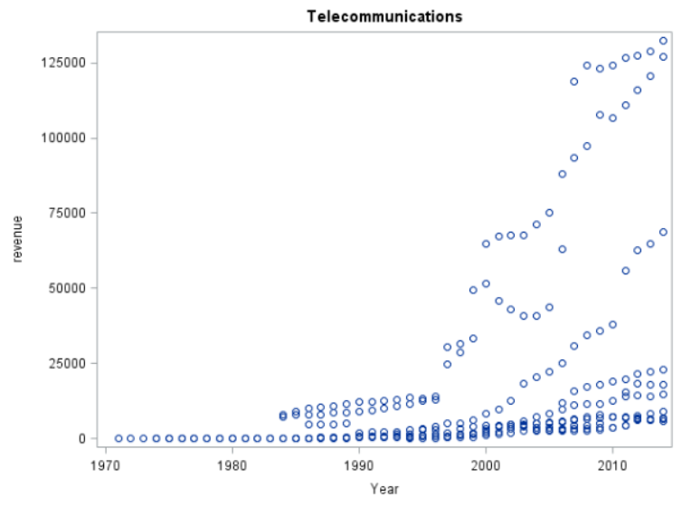
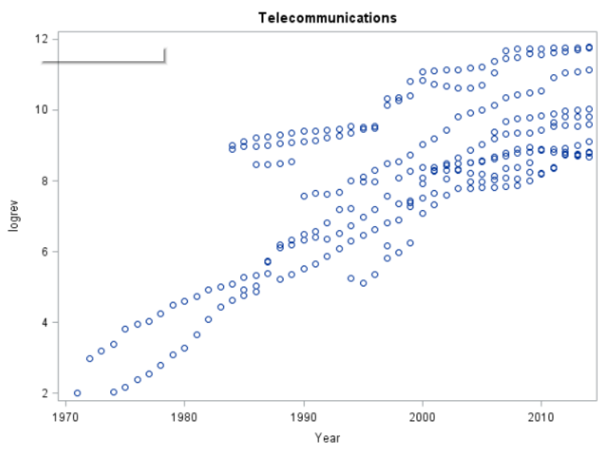
Telecommunications: Revenue vs. year
Previous Outcome
New Outcome
Telecommunications
Telecommunications
Revenue
Revenue
Year
Year

Slide 49
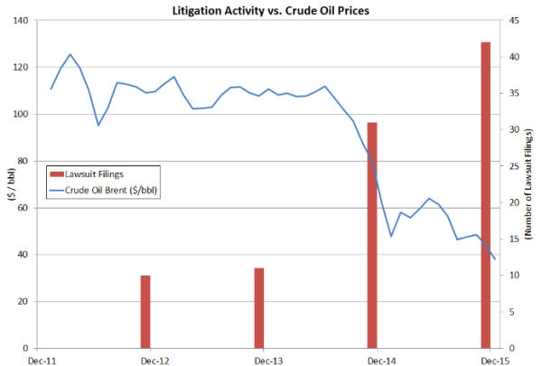
Relationships between variables
Oil & Gas Equipment, Services
Source: WilmerHale, http://www.mondaq.com/unitedstates/x/471250/Oil+Gas+Electricity/As+Oil+Prices+Descend+Patent+Enforcement+Litigation+Increases+Within+Energy+Industry
Notes:
The direction of these relationships cannot be determined from this study, though research reveals that companies within this specialty rely on their patents to generate revenue when oil prices decline. They do this by licensing their patents to other companies or suing competitors over patent infringement.

Slide 50
Specialties with Strong Linear Relationships between R&D, Patent, & Revenue
Oil & Gas Equipment, Services
Tobacco
Computers, Office Equipment
Petroleum Refining

